Slide 1
Solar Desiccant Air Conditioning
Arian Nadertabar
Diego Guardia
Javier Borrase
Rick Parra

Slide 2
External Parameters
Outdoor Temperature
Indoor Temperature
Outdoor Relative Humidity
Indoor Relative Humidity
*How big is the space you are attempting to cool?

Slide 4
Desiccant Wheel
Desiccants (also known as hygroscopic substances) can be solid or liquid
Silica Gel
Rotates Slowly
Takes in warm humid air on the supply inlet (bottom)
Takes in hot humid air from the reactivation inlet (top)
Regenerates at high temperatures (250 degrees F)

Slide 5
Desiccant Wheel

Slide 6
Thermal Wheel
Lower Chamber: Recovers thermal energy from the dried (processed) air which had run through the desiccant
Lower Chamber: Cools processed supply air
Top Chamber: Preheats the reactivation air that will be used to regenerate the desiccant

Slide 10
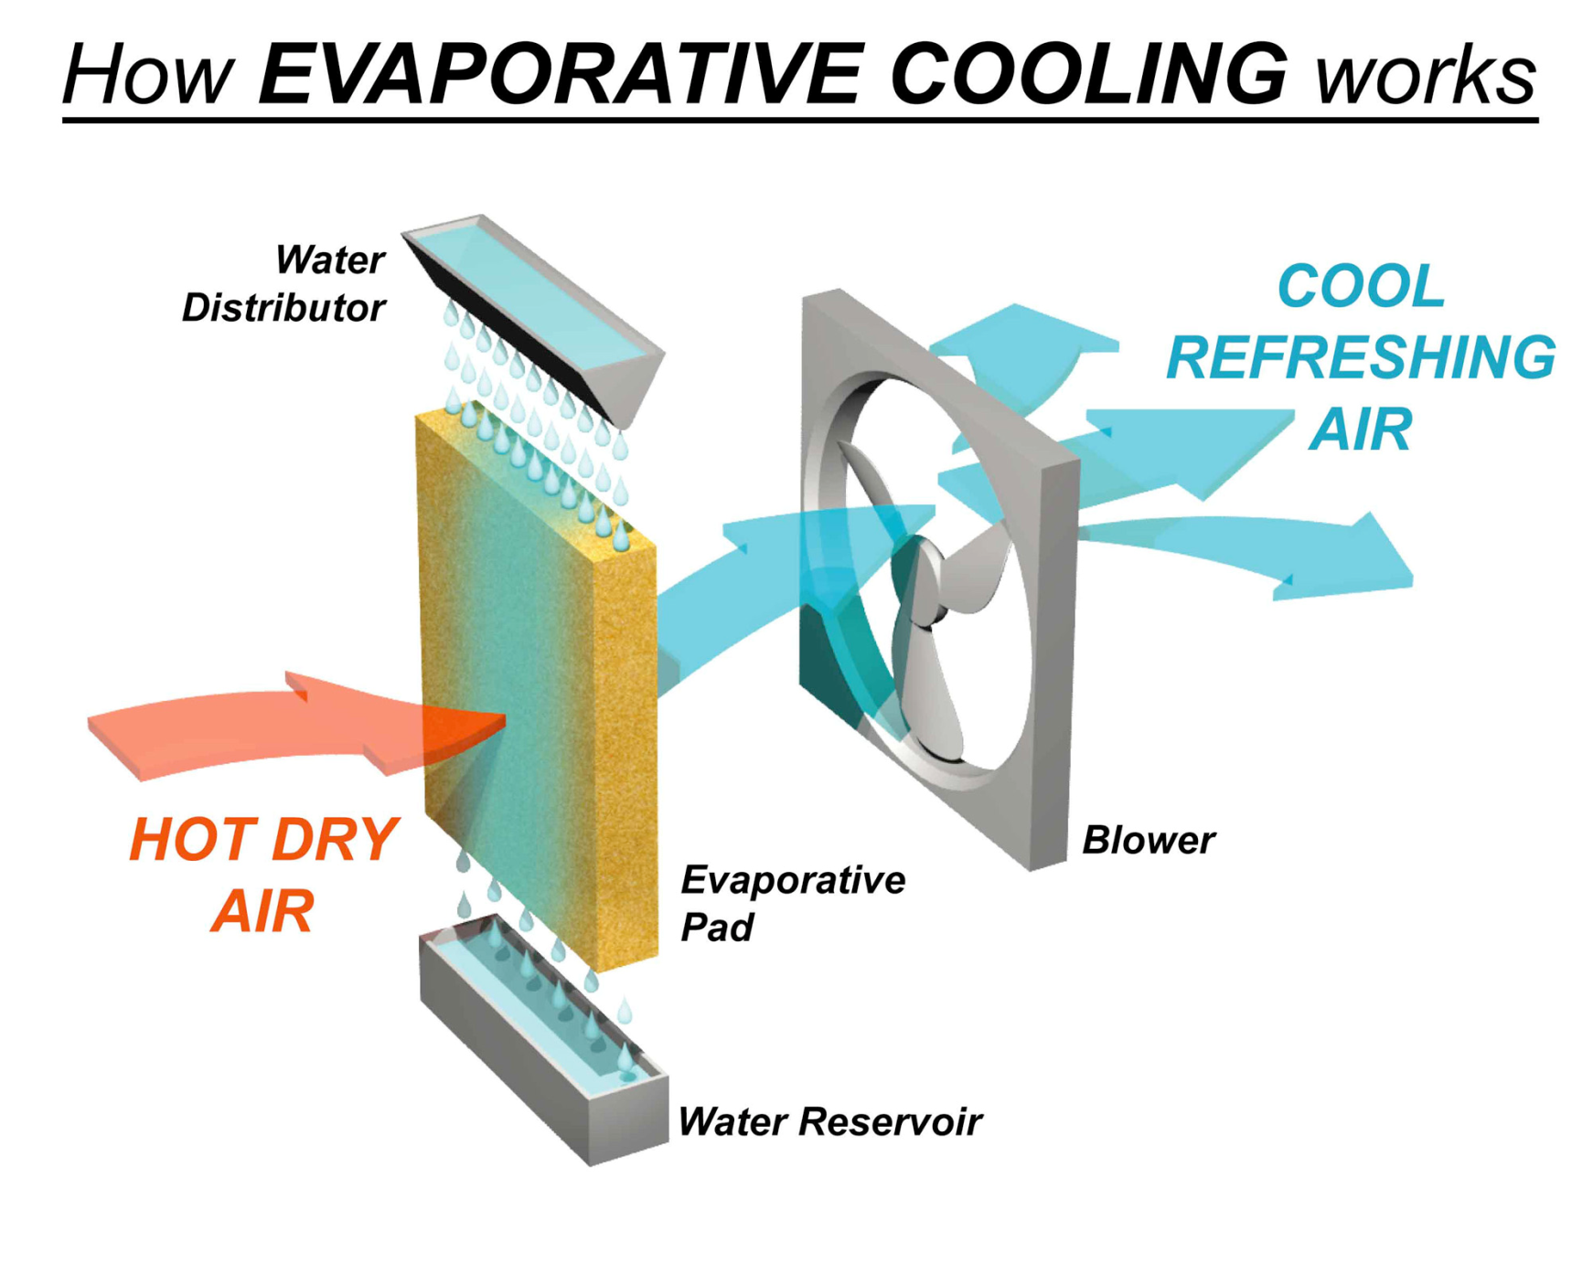

Slide 11
Air to water heat exchanger (Radiator)
Passes thermal energy from the solar heated water to the preheated air from the thermal wheel
Water Glycol Solution or pure glycol?
Water-Glycol Solution: 5% Water, 95% Glycol
Constraint: Water boils at 212 degrees Fahrenheit

Slide 12
Solar Panel:
Solar apparatus acts as a solar water heater
Is the use of the solar panel economically feasible?
Heat source can come from anything theoretically (i.e. heating coil)

Slide 13
Miscellaneous
80 Degree Air with R.H. of 60 % with Soaked Pad at 70 degrees could yield 75 degree air with R.H. of 76 %.
85 Degree Air with R.H. of 60 % with the same conditions would yield 75 degree air with R.H. of 111 % (impossible!!!)
Dry air 85 degrees Fahrenheit good candidate for evaporative cooling for terminal stage of the supply chamber.

Slide 14
Conclusion
Difficult to Model
Difficulty of achieving steady-state
Assume Steady State for calculations

Slide 15
Questions?

